Slide 1
Manual Task Mapping Template

Slide 2
1. Identify Cell Customer
Who / what receives the parts that the cell is making?

Slide 3
2. Cell Output
“What I need you to give me to do my work is … so I can ...”
Drawings, pictures and videos

Slide 4
2. Cell Output
Parts Presentation - How are the parts arranged at output?
Are the parts singulated? What is the space around them?
Placed one by one
Placed stacked on top of each other
Placed stacked side by side
What is the packaging?
On a table
In a fixture
In a tray
Stack of tray
Random bin

Slide 5
2. Cell Output
Is the output target moving?
On a moving conveyor
On a stable surface
Drawings, pictures and videos

Slide 6
3. Cell Input
Parts
Number of parts
How many different parts need to be handled, processed at the station?
Characteristics of the parts
Dimension
Weight
Material
Variation in time
Are there changeovers at this station?
Are you planning to introduce new parts in the near future?
Drawings, pictures and videos

Slide 7
3. Cell Input
Part presentation - How are the parts arranged at input?
Are the parts singulated? What is the space around them?
Come one by one
Come stacked on top of each other
Come stacked side by side
What is the packaging?
On a table
In a fixture
In a tray
Stack of tray
Random bin

Slide 8
3. Cell Input
Are parts moving when presented?
Stopped when picked
On a moving conveyor
Drawings, pictures and videos

Slide 9
4. Define Process
List the steps
Value-added, nonvalue-added
Take video

Slide 10
5. Document Information Flow
Information for the manual operator, where it comes from, where it goes, what it looks like and how it impacts something.
Information | Coming from | Going to | Format | How it's used

Slide 11
6. Measure KPI
What are the current KPI targets
How are they measured?

Slide 12
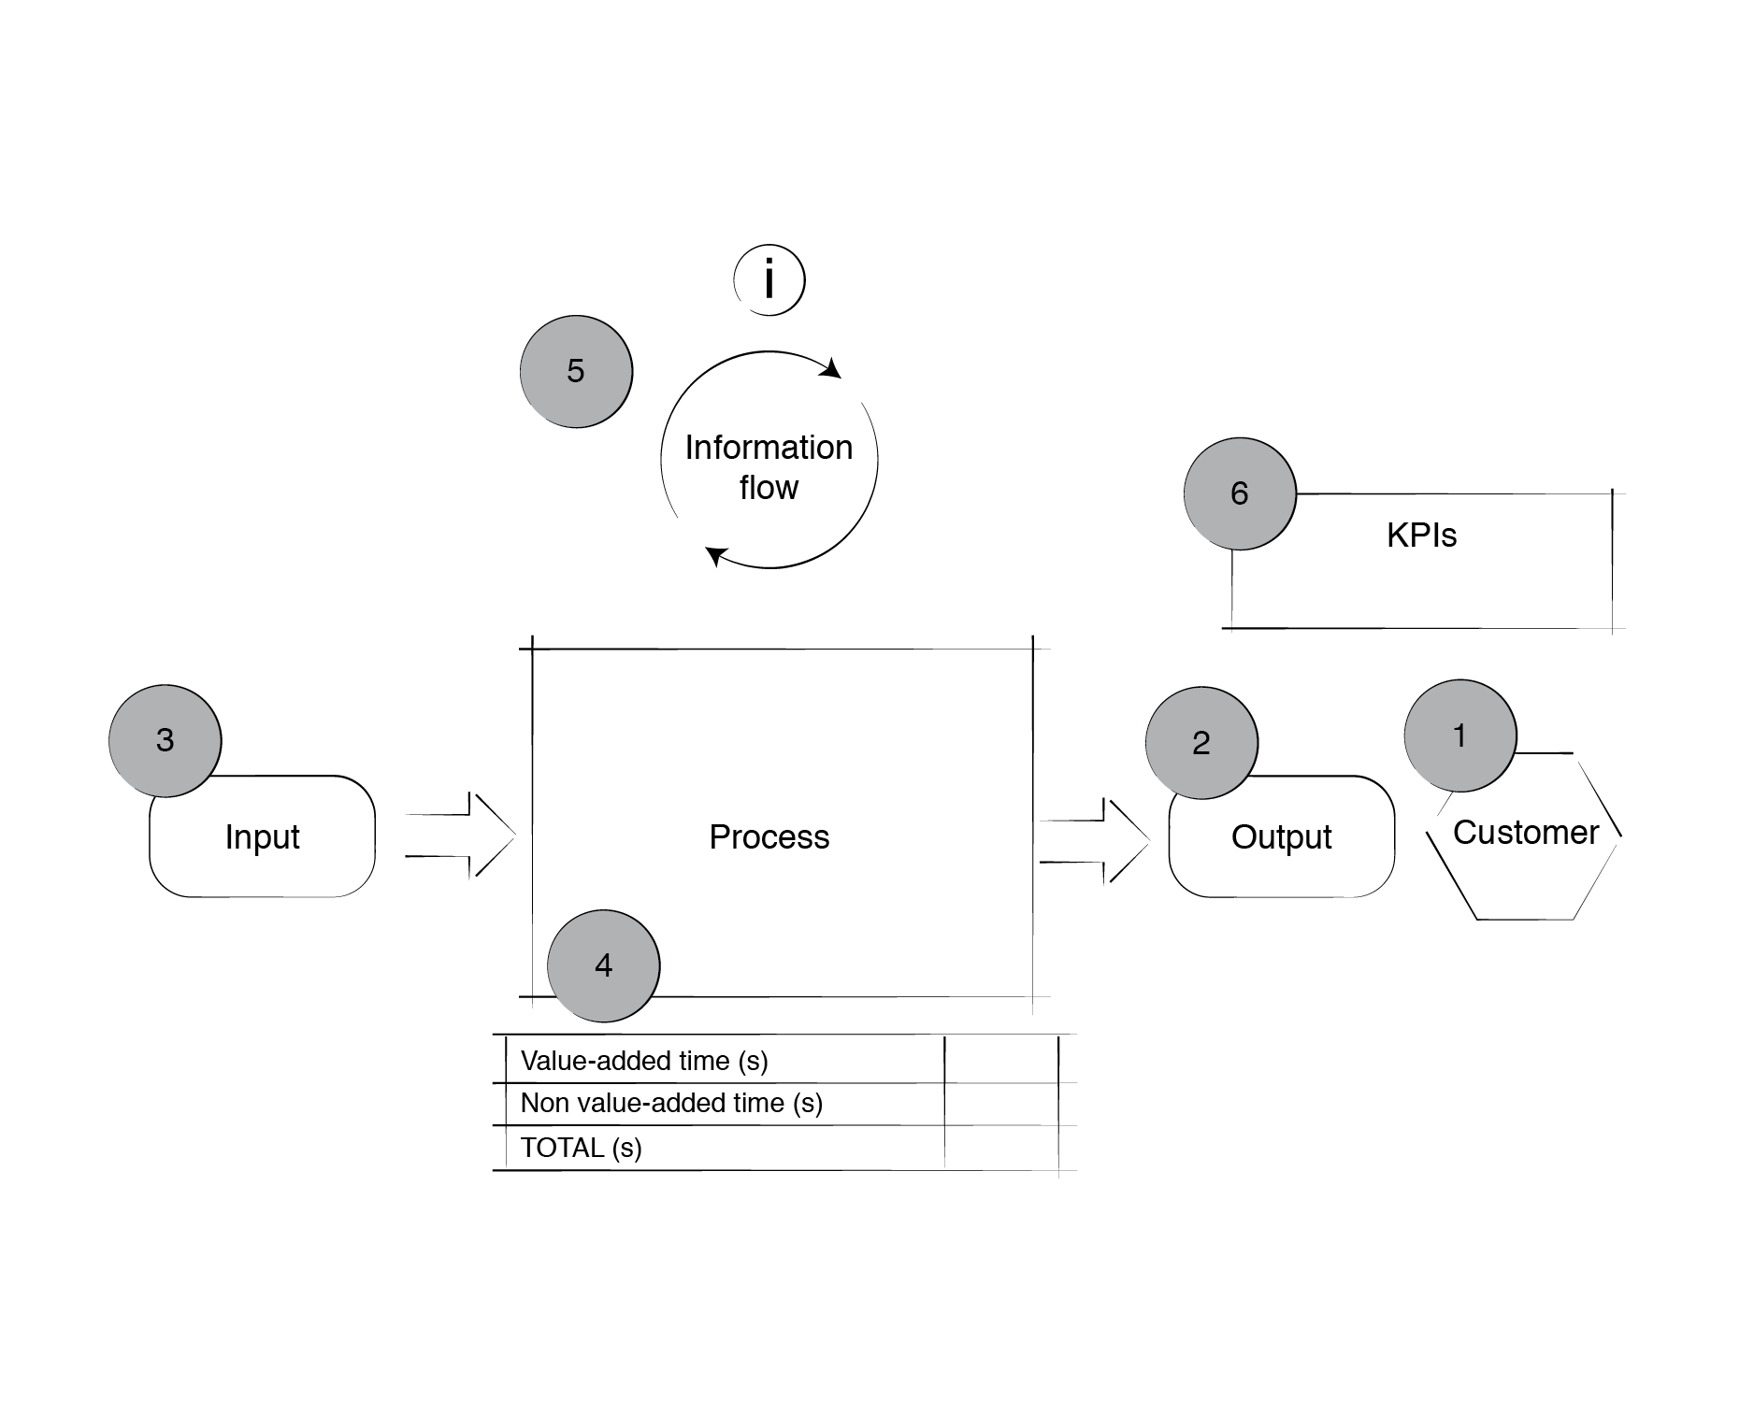
7. Manual Task Summary

